Slide 1
APPLIED AI
HAMNA IFTIKHAR 2020146
HASSAN IBRAR 2020306

Slide 2
AGENDA
ABSTRACT
AUDIENCE
MOCKUPS

Slide 3
MARIAM CHATBOT APPLICATIONS
Abstract:
This project introduces Mariam, a versatile chatbot designed for dual applications. In the first domain, Mariam serves as a household assistant chef, utilizing user-provided limited ingredients to suggest dishes and redirecting users to corresponding YouTube recipe videos. In the second application, Mariam transforms into a teaching assistant for kindergarten students, engaging them with interactive storytelling culminating in valuable moral lessons.

Slide 4
AUDIENCE

Slide 5
AUDIENCE
MARIAM AS CHEFF: HOUSEWIVES
MARIAM AS TEACHING ASSISSTANT: KINDERGARTEN STUDENTS

Slide 6
MOCK-UPS

Slide 7
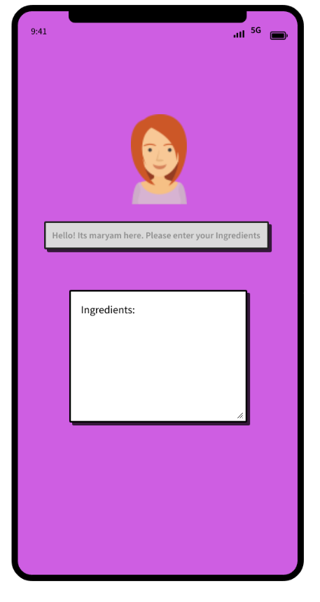
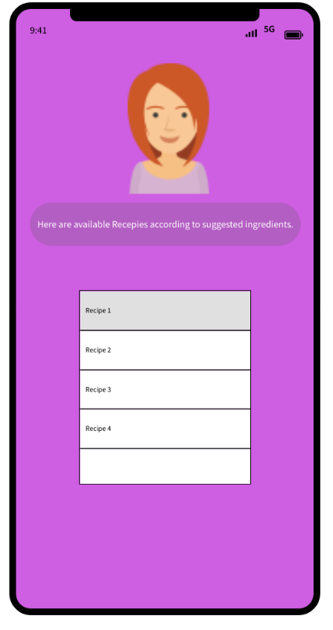
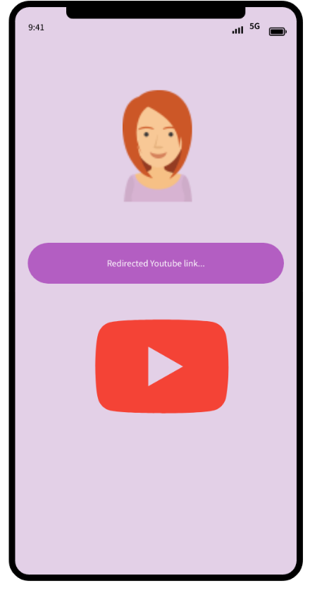
Mariam as chef

Slide 8
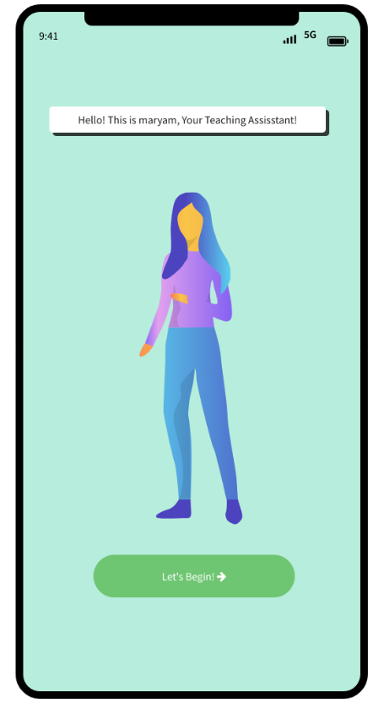
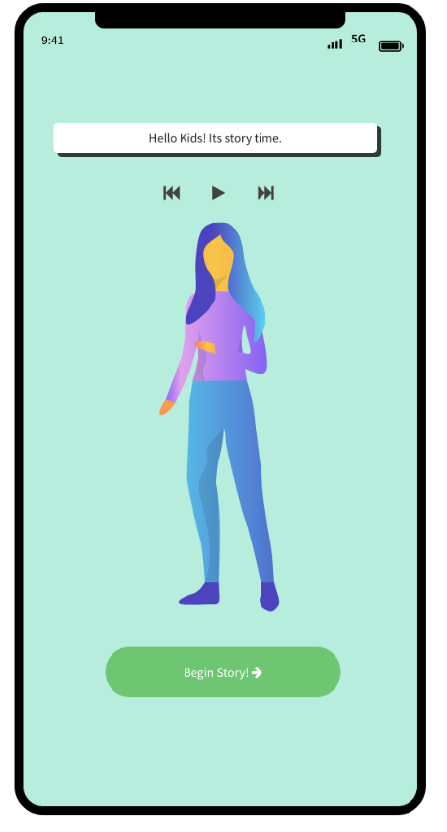
Mariam as Teaching assistant

Slide 9
Work-flows

Slide 10
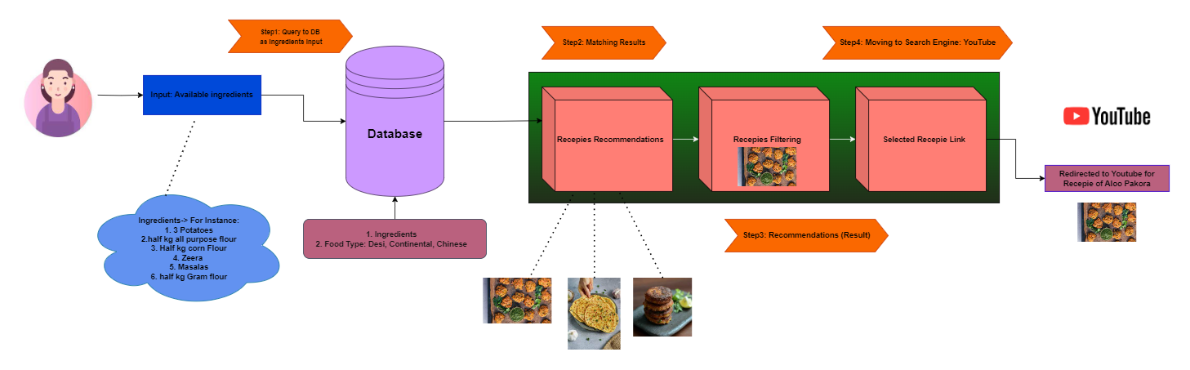
Mariam as chef

Slide 11
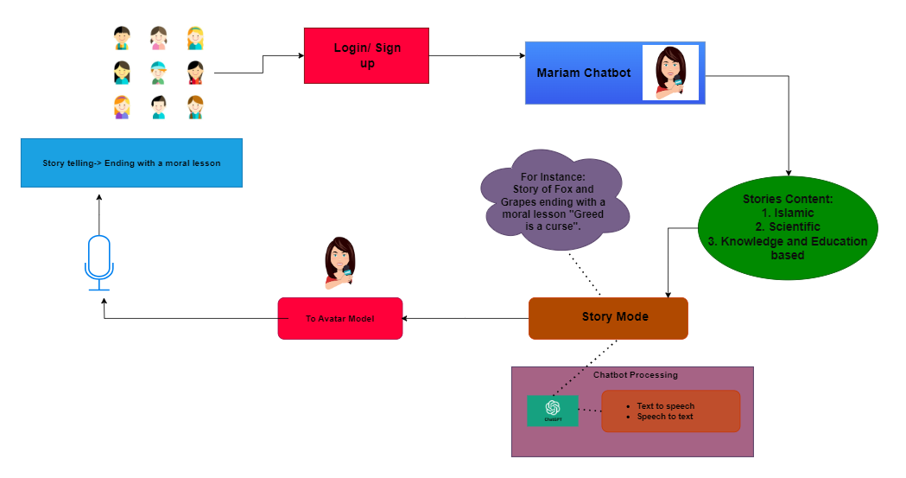
Mariam as Teaching assistant

Slide 12
THANK YOU

